Slide 1


Oral Communication Skills B
(CELEN082)
Lesson 7.1

Slide 2
Lesson aims and objectives
Introduce PowerPoint Slides assessed task. Increase awareness of three key elements of visual aid creation: design, text and animation. Apply taught knowledge to develop a set of guidelines for visual aid creation. Practise applying taught knowledge about the three key elements of visual aid creation to own PowerPoint slides.

Slide 3

Getting started

Slide 4
Getting started
For homework, you were asked to create draft PPT slides for your Final Presentation.
In your group, show each other the slides you created and complete the tasks below.
Decide which student’s slides look the best. Give at least two reasons to justify your decision.
Decide which student’s slides present information the most effectively. Give at least two reasons to justify your decision.

Slide 5
PowerPoint Slides
Assessment

Slide 6
PowerPoint Slides Task
For homework, you were asked to read Appendix 2: PowerPoint Slides information section from the OCSb Module Handbook, and the OCSb 24-25 PowerPoint Slides (MARKING CRITERIA) document from the Assessment section on Moodle.
In groups, answer the questions below.
1. When do you need to submit the PPT slides for the assessed PowerPoint Slides task?
2. What file type should you submit for the assessed PowerPoint Slides task?
3. What are the required slides that your PPT should include?
4. When explaining your chosen problem, what information should you include?
5. When explaining each solution, what information should you include?

Slide 7
PowerPoint Slides Task
1. When do you need to submit the PPT slides for the assessed PowerPoint Slides task?
before Monday, 7th April, 3pm
2. What file type should you submit for the assessed PowerPoint Slides task?
.ppt
For more details read the Appendix 1: PowerPoint Slides information section from the OCSa Module Handbook.

Slide 8
PowerPoint Slides Task: Review
3. What are the required slides that your PPT should include?
Title (This was covered in Lesson 6.1.)
Overview (This was covered in Lesson 6.1.)
Problem
Solution 1 (+ evaluation)
Solution 2 (+ evaluation)
Conclusion (This was covered in Lesson 6.2.)
Reference list (For the PowerPoint Slides task, it should be clear from each reference where the source came from, but an accurate Harvard style is not required for the citations/ reference list.)
Please note that this is the minimum required number of slides. You are likely to need more slides, depending on the content of each section.

Slide 9
PowerPoint Slides Task: Review
4. When explaining your chosen problem, what information should you include?
Explanation
Causes
Significance/ Impact
5. When explaining each solution, what information should you include?
Explanation (the solution should be linked to one of the causes of the problem)
include sufficient detail to make sure it’s clear what the solution is BUT remember that you should provide most detail/explanation orally
Evaluation
this should be based on criteria, balanced, and supported with logic and / or evidence

Slide 10
PowerPoint
(Design)

Slide 11

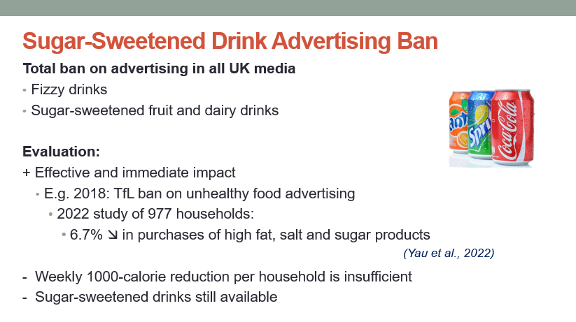

PowerPoint: Design
Compare the design of two PowerPoint slides and complete the tasks below:
Decide which slide is more effective.
Give at least seven reasons for your decision. Use your OCSb Workbook for making notes.
✗
✓
A
B

Slide 12
PowerPoint: Design
(1) Easy to read font
(5) Picture relevant to slide information
(4) Slide heading included
(6) Citations included on slide
(2) Background colour and (3) font colour contrast with each other → easy to read
(7) Use of space is efficient

Slide 13
PowerPoint: Design
(4) Missing slide heading
(5) Picture not relevant to information on slide
(1) Difficult to read font
→ ‘straight’ line fonts (e.g. Calibri, Arial) are easier to read
(2) Background colour and (3) font colour are too similar = lack of contrast
(7) Unnecessary design element = waste of space
(6) Missing citation

Slide 14
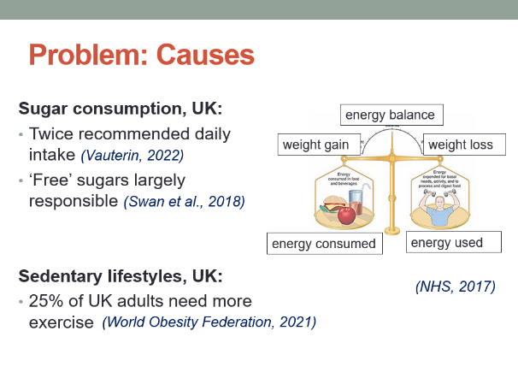
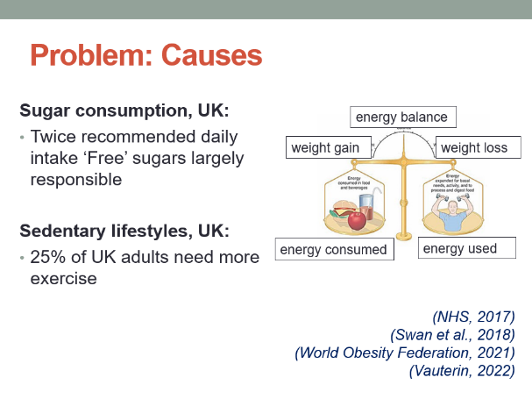


PowerPoint: Design
Analyse two more pairs of PowerPoint slides. For each pair, decide which slide has the most logically positioned citations.
A
B
A
B

Slide 15
PowerPoint: Design
✓
A
B
This slide has the most logically positioned citations.
The information comes from four different sources.
It is clear which piece of information comes from which source.

Slide 16
PowerPoint: Design
✓
A
B
This slide has the most logically positioned citations.
It is clear that ALL the information comes from the same source.
It is unnecessary to repeat the citation as it adds unneeded text.

Slide 17
Your own slides
Using what you have learnt about the design of PowerPoint slides, make improvements to the slides that you created for the problem section of your Final Presentation. Use the checklist below to help you:
 | Guidelines
Design | Use a font colour that contrasts with your background. Use easy to read fonts. Include slide headings. Use logical pictures. Include citations on your slides and position them logically. For pictures, you should only use citations if they’re PART of your presentation NOT if they are decorative. Don’t include design elements that waste space.
Do you still agree that the student you chose at the start has the best-looking slides?

Slide 18
PowerPoint
(Text)

Slide 19


PowerPoint: Text
Compare the use of ‘text’ in two PowerPoint slides and complete the tasks below:
Decide which slide is more effective.
Give at least eight reasons for your decision.
✓
✗
A
B

Slide 20
PowerPoint: Text
(2) Non-capitalisation of key word in title
(3) Spelling errors
(7) Use of different grammar structures in main points (i.e. full sentence, noun phrase, question)
(4) Illogical font sizes = title smaller than text
(5) Main points are not easy to identify
→ they should be in ‘bold’ or ‘underlined’
(8) Font size is too small to read
(6) Inconsistent use of capital letters
(1) Too much text on slide

Slide 21
PowerPoint
(Supporting ideas)

Slide 22

PowerPoint: Supporting ideas
Experienced presenters use examples and research studies to support their ideas.
It is important that there is a balance between the information included on the slide (as text) and the information provided orally when explaining these supporting ideas.

Slide 23
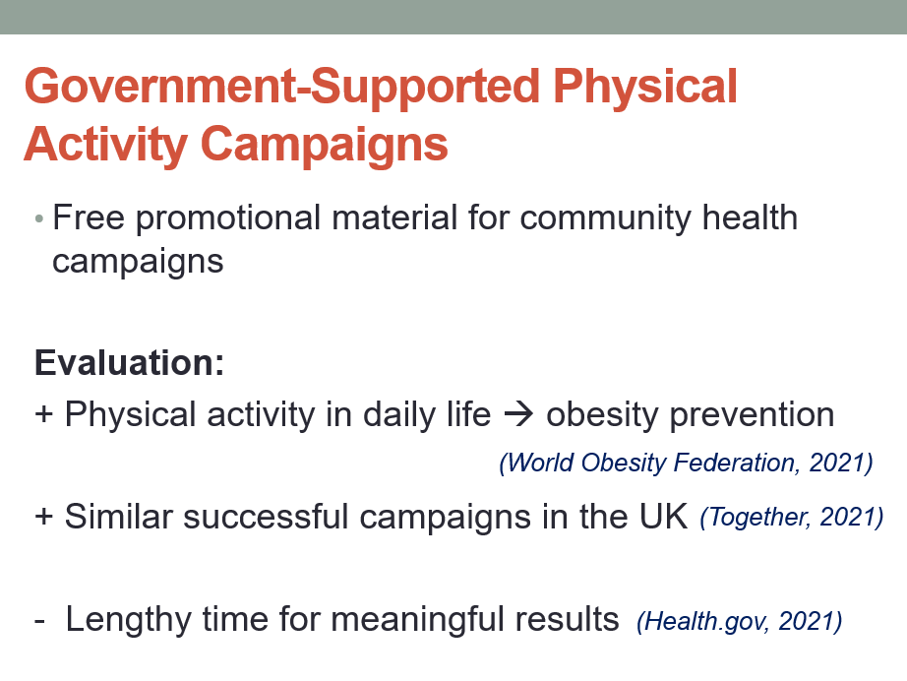

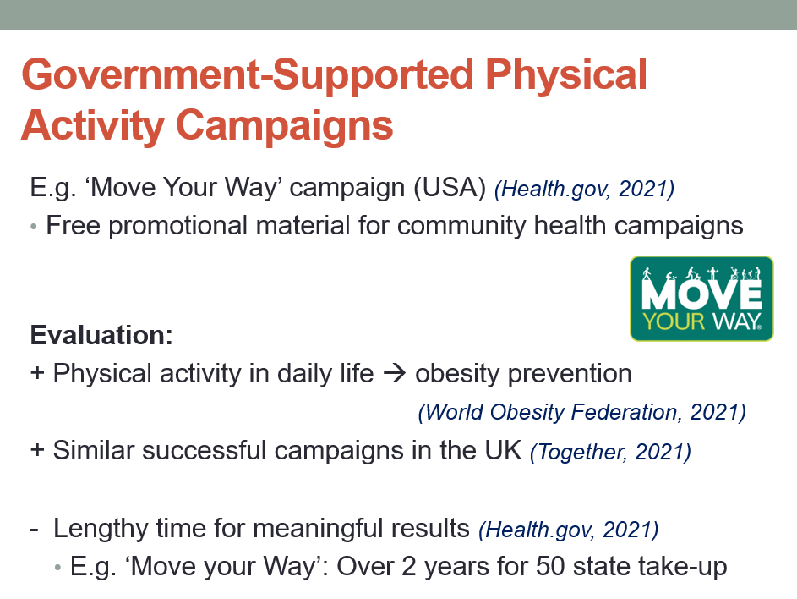
PowerPoint: Supporting ideas
Compare the way the text is used to introduce support for ideas (e.g. examples and evidence from research studies) in three PowerPoint slides and complete the tasks below.
Decide which slide is the most effective.
Give at least two reasons for your decision.
✗
✗
✓
A
B
C
Not enough information
Too much information

Slide 24
PowerPoint: Supporting ideas
This slide is the most effective.
It provides basic details about the example taken from research:
the name: ‘Move Your Way’
the location: USA
the main points:
free promotional material …
over 2 years …
The audience has to listen to get further details.

Slide 25

PowerPoint: Presenting a research study
Analyse the way the text is used to present a research study. Decide which of the information below is presented on the slide.
General subject of research
Time period of research
Basic details of the research method
Specific details about how the research was conducted
Main relevant finding(s) of research
Explanation of finding(s)
✓
✓
✓
Unnecessary information
✗
✓
✗
Should be provided orally

Slide 26
PowerPoint
(Animations)

Slide 27
PowerPoint: Animations
Watch an experienced speaker present a short extract of a presentation and complete the tasks below:
Identify at least one animation technique the speaker uses to present information on their slide.
Think of at least one reason why the speaker does this.
Animation techniques:
The speaker reveals the information on the slide gradually.
The speaker first introduces the next idea before moving to the next slide.

Slide 28
PowerPoint: Animations
Animation can be useful when you want the audience to focus on different points as you explain your ideas.
Instead of having all of the elements appear on the slide at the start, you reveal each point as you speak about it. This will help the audience focus on what you are saying rather then reading the information on the slide ahead of you.

Slide 29
Your own slides
Using what you have learnt about the use of text and animation in PowerPoint slides, make improvements to the slides that you created for your Final Presentation. Use the checklist below to help you:
 | Guidelines
Text | Don‘t use too much text on the slide (use bullet points). Be consistent (e.g. capital letters). Distinguish between titles, main points, and supporting points. e.g. font size, indentation, bold, colour etc. Check your spelling and grammar. Use the same grammar structures where possible on each slide. Show the audience you can support your ideas with examples, but only include general information on the slide.
Animation | Try to reveal the text on your slide gradually rather than all at once.
Do you still agree that the student you chose at the start presents information the most effectively?

Slide 30
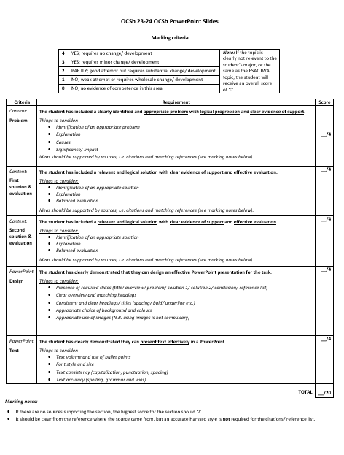
PowerPoint Slides Assessment
Submit your full PPT (as a .ppt document) via Moodle in Week 8 (Monday 7th April, 3pm).
This is an ASSESSED piece of work.
Review the OCSb 24-25 PowerPoint Slides (MARKING CRITERIA) document from the Assessment section on Moodle.
You can use the checklists from the Workbook (end of Lesson 7.1) to develop and improve your slides.

Slide 31
Homework
Due | Task
Lesson 9.1 | Watch the video called ‘Body Language for Presentations’ (link on Moodle in the Week 9 section) and take notes to answer the questions below. Bring your notes to class. How should presenters use eye contact and smiling? How should presenters stand and use gestures? How can presenters use their head?
Self-Study
Visit the Microsoft PowerPoint training guide: PowerPoint for Windows training (microsoft.com) (link on Moodle in the Assessment section).

